Slide 1
TITO EF5 Simulation/Ouputs info

Slide 2
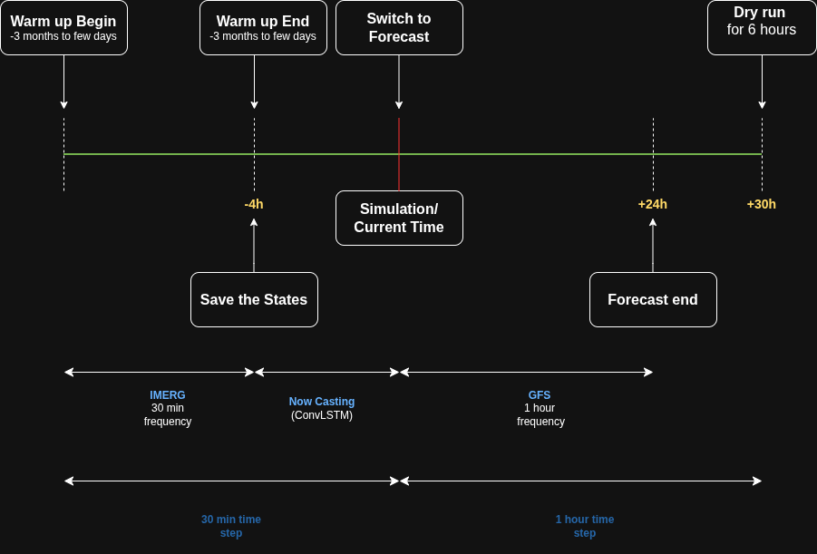
First Run
We Start with warmup states or run a warmup for 3 months to 1 year.
We always save the states at the latest IMERG which comes with a delay of 4 hours.
We fill the delay from -4hour(last latest IMERG) till the current time/simulation time with nowcasting Convolutional LSTM (ConvLSTM).
We then switch to Forecast/Long Range mode using GFS and run a forecast till +24 hours.

Slide 3
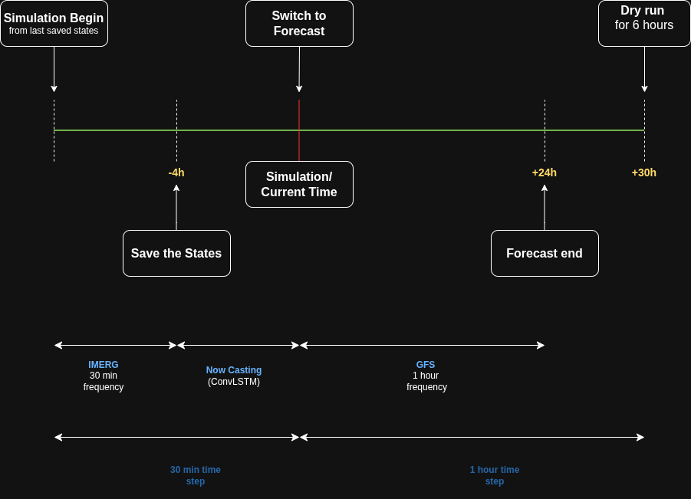
Second Run
From the next runs we start from the saved states from the last run, at this point we get 1 hour of new IMERG.
We again save the states at -4 hour on the latest IMERG.
Rest everything is same.

Slide 4
Second Run
From the next runs we start from the saved states from the last run, at this point we get 1 hour of new IMERG.
We again save the states at -4 hour on the latest IMERG.
Rest everything is same.

Slide 5
Outputs
Each Simulation produces the below outputs
Max Unit Stream Flow (m³/Sec/Km²).
Max Stream Flow (m³/Sec).
Max Soil Moisture (0 – 100 %).
QPE: Quantitative Precipitation Estimation accumulated (via IMERG + Nowcasting).
QPF: Quantitative Precipitation Forecast accumulated (via GFS).
Max Depth: Inundation

Slide 6

Geo Tiffs Metadata
Each Geotiff consist of meta data
Metadata consist of simulation begin and end date timestamp
Example for a simulation run at 202606101600 has:
Start – 202606101100
IMERG_End – 202606101600
GFS_Begin - 202606101600
End – 202606112200
Meta data from
Max Unit Stream Flow

Slide 7


Geo Tiffs Metadata
Meta data from :
Max Unit Stream Flow
QPE Accum (Coming from IMERG + Nowcasting)
QPF Accum (Coming from GFS)

Slide 8
Geo Tiffs Metadata
Each Geotiff consist of meta data
Metadata consist of simulation begin and end date timestamp
Example for a simulation run at 202606101600 has:
Start – 202606101100
IMERG_End – 202606101600
GFS_Begin - 202606101600
End – 202606112200
Meta data from
QPE Accum (Coming from IMERG + Nowcasting)

Slide 9
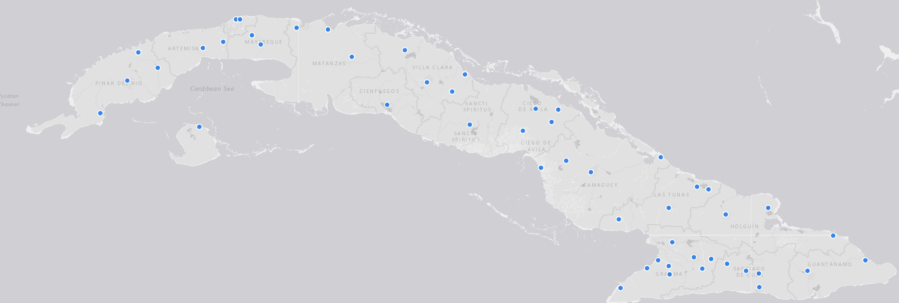
Timeseries
In the outputs we also get timeseries across below selected locations in the form of csv’s

Slide 10
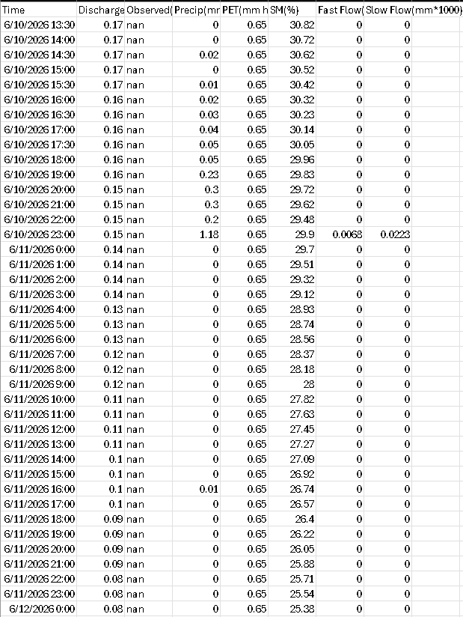
Timeseries
Each CSV contains the below information
Time Stamp
Discharge
Observed (not applicable)
Precipitation
PET
Fast Flow
Slow Flow

